Slide 1
Ulm University Institute of Technology and Process Management School of Advanced Professional Studies
Business Analytics Drives Innovation
Day 2 KNIME Transfer Task
Saraç, Burçin
Tutors,
Bujar Ramosaj, Daniel Gentner
Prof. Leo Brecht

Slide 2
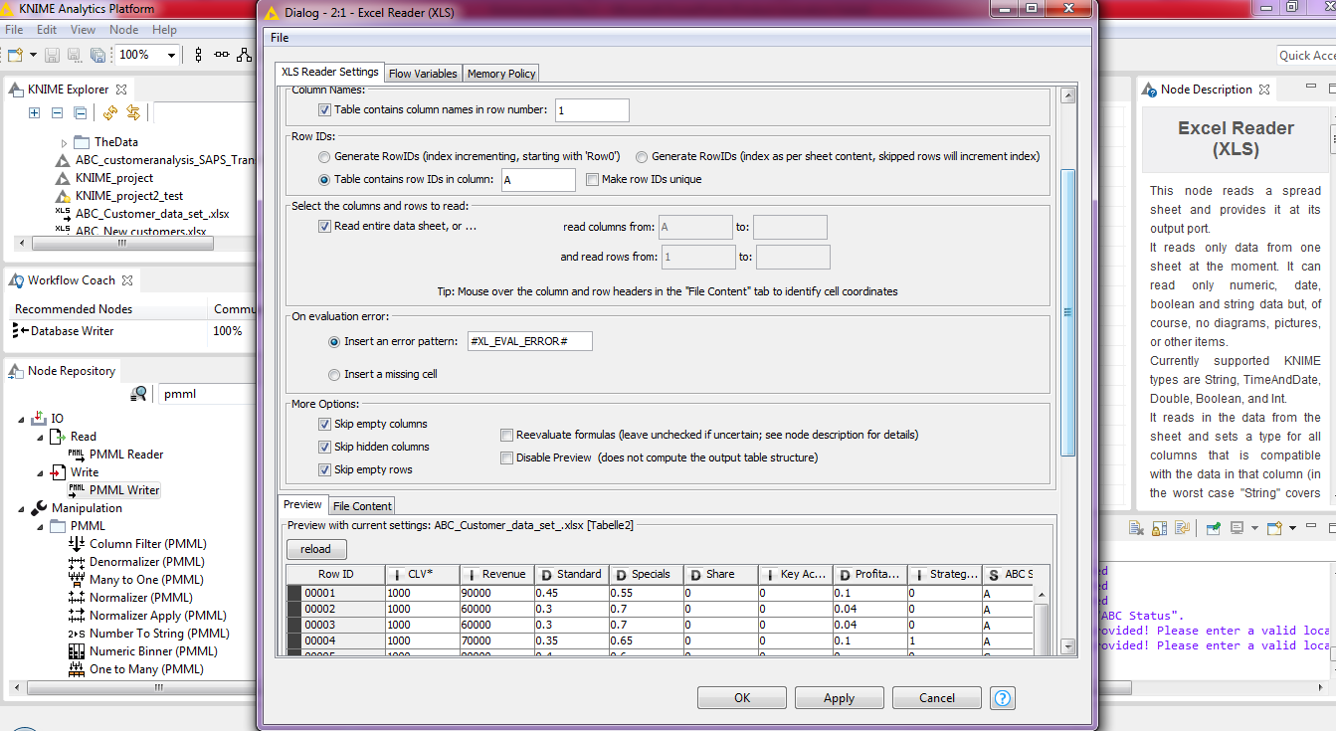
Firstly, we integrate our data to the KNIME with Excel Reader Node and determine details for better usage of our data during prediction, like RowID.

Slide 3
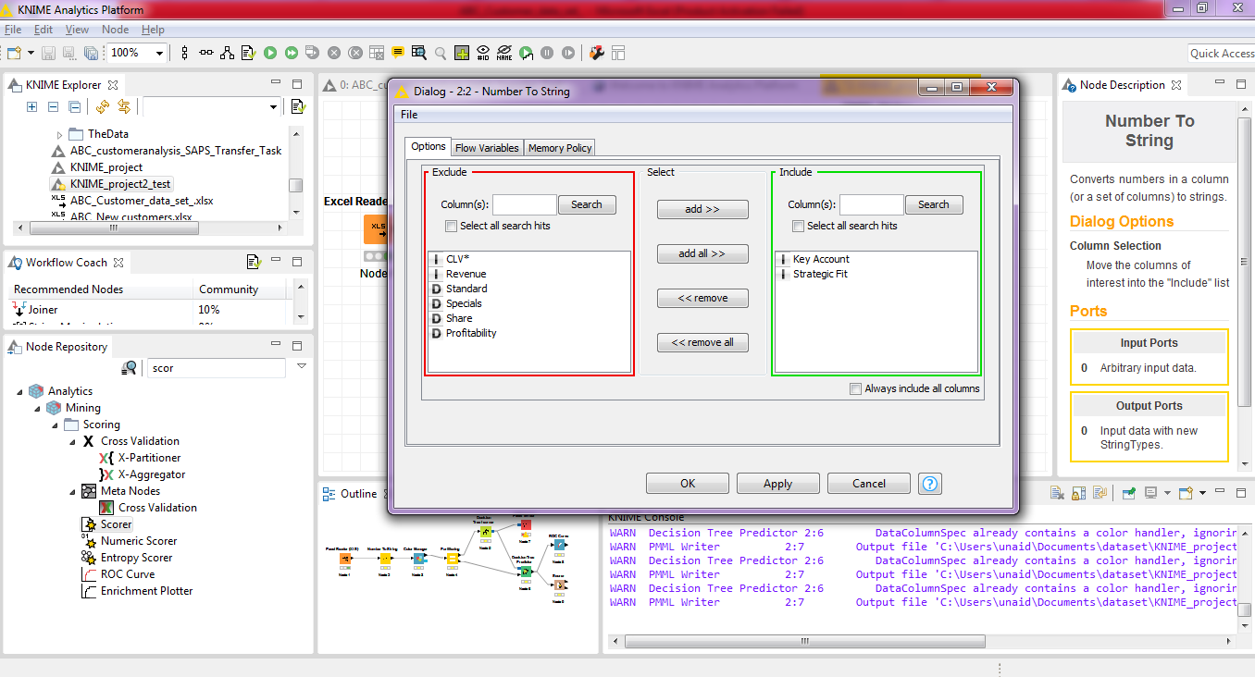
In our data set ‘Key Acount’ and ‘Strategic Fit’ columns have to be strings as factors, so we can use Number to String Node to set that.

Slide 4
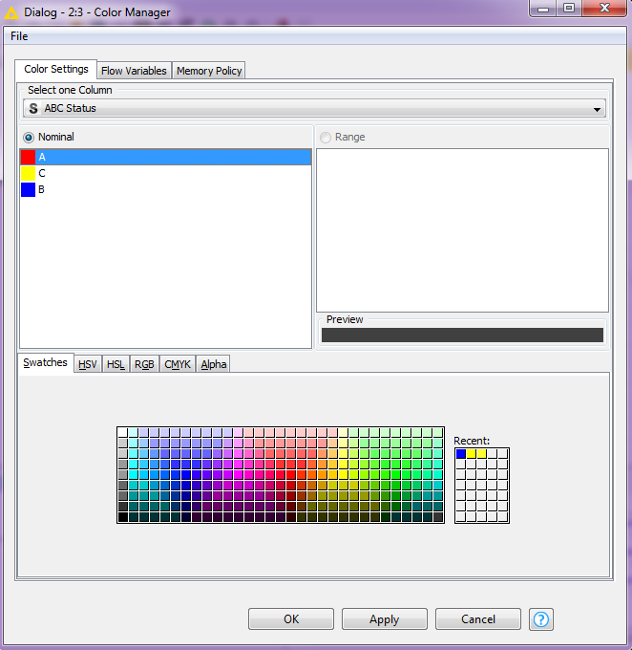
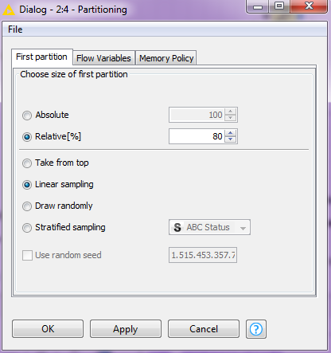
In subsequent nodes, - we determine colors of customer status, - we divide 80% of our data for decision tree model training and therefore 20% of our data will be used for model accuracy testing as an unseen data for our model. As a first approach I tried ‘Stratified Sampling ‘ method for prediction, however the accuracy of this model was 80.1%. In the second aproach, I tried ‘Linear Sampling ‘ method and get little bit better results in predictions(80.3%), so I decided to use this method to separate the training and test data.

Slide 5
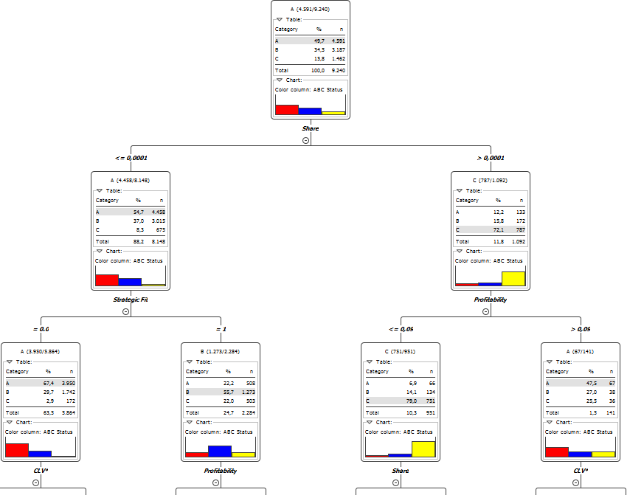
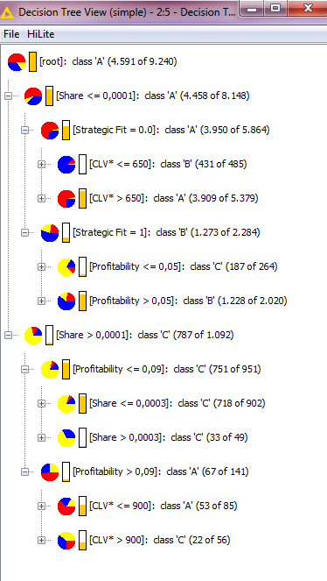
After implementing our Decision Tree model to the training data, our decision tree created with A Status as our root entropy with highest information gain. And with the helps of our decision tree view, we can determine our most effective inputs for prediction. It seems from the tree that, the most influencing feature is ‘Share’. If share of customer is bigger than 0.0001, that customers status tend to be ‘C’. And the subsequent effective attributes are respectively ‘Profitability’, ‘Strategic Fit’ and ‘CLV’ for determining the Status of customers. If ‘Strategic Fit’ data is 0 and ‘CLV’ is bigger than 650, then customer status tend to be A, otherwise B. On the other hand, it shown on the table that, if we evaluate our tree more detailed, as an example among customers which has bigger than 0.0001 ‘Share’ ; ‘Profitability’ of customer is higher than 0.9 and ‘CLV’ is higher than 900 and at last ‘Strategic Fit’ data is equal to 1, it is always results to be a type A Customer, however it won’t be an accurate prediction by itself only, because there are a few data for training in this entropy. Addition to this, we can roughly say decrease in profitability, causes to become status C customer, nevertheless it is not a proper assumption by itself as well.

Slide 6
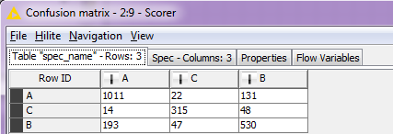
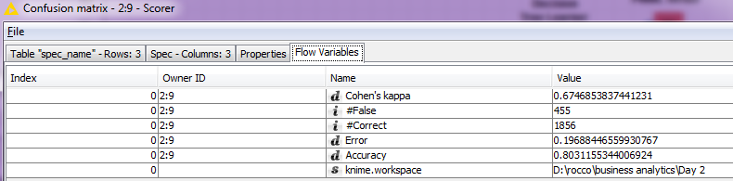
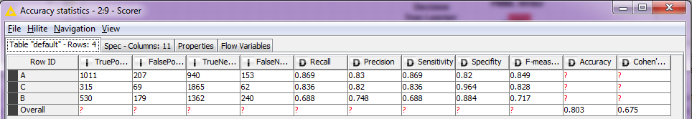
After we train our model and implement it to our test data, with the helps of Scorer Node, we can evaluate the accuracy of model prediction and cross check the predicted data with the correct answers. In our case, our model’s accuracy occurs roughly 80.3%. Moreover, our model predicts 1856 of our customers correctly, but it seems that, there are 455 wrong predictions overall. For example, our model predicts 1011 of Status A customers right, however it predicts wrongly to 14 of our customers as C, and 193 of our customers as B. Unlike shared KNIME workflow, in this example we cannot use ROC Curve because our model predicts multiclass classification.

Slide 7
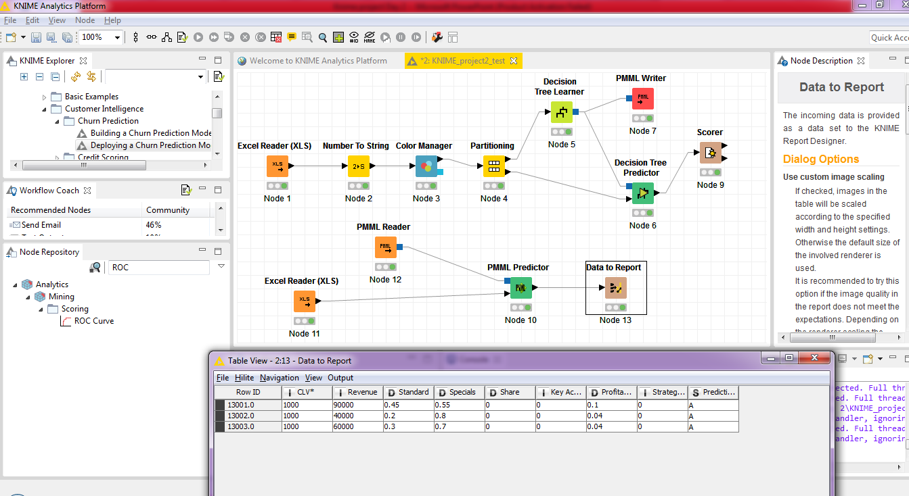
At last, if we implement our decision tree model to our new customers, our model predicts all of new customers in Status A.

